Slide 1
FIRE DOOR INSPECTIONS
HAMBURG OVERHEAD DOOR PRESENTS:
NFPA 80 STANDARDS
THIS STANDARD REGULATES THE INSTALLATION AND MAINTENANCE OF ASSEMBLIES AND DEVICES USED TO PROTECT OPENINGS IN WALLS, FLOORS, AND CEILINGS AGAINST THE SPREAD OF FIRE AND SMOKE WITHIN, INTO, OR OUT OF BUILDINGS.

Slide 2

1.1.1
REQUIREMENTS
. 1.1.1.WITH THE EXCEPTION OF FABRIC FIRE SAFETY CURTAIN ASSEMBLIES, THIS STANDARD ADDRESSES ASSEMBLIES THAT HAVE BEEN SUBJECTED TO STANDARDIZED FIRE TESTS.

Slide 3

1.1.3 REQUIREMENTS
1.1.3 REQUIREMENTS FOR HORIZONTALLY SLIDING, VERTICALLY SLIDING AND SWINGING DOORS AS USED IN THIS STANDARD DO NOT APPLY TO HOIST WAY DOORS FOR ELEVATORS AND DUMBWAITERS.

Slide 4

1.1.4 REQUIREMENTS
1.1.4 THIS STANDARD DOES NOT COVER FIRE RESISTANCE GLAZING MATERIALS AND HORIZONTALLY SLIDING ACCORDION OR FOLDING ESSEMBLIES FABRICATED FOR USE AS WALLS AND TESTED AS WALL ASSEMBLIES IN ACCORDANCE WITH NFPA 251, STANDARD METHODS OF TESTS OF FIRE RESISTANCE OF BUILDING CONSTRUCITON AND MATERIALS.

Slide 5
WHY CHOOSE HAMBURG OVERHEAD DOOR FOR YOUR INSPECTIONS?
Hamburg Overhead Door Inc. will drop test and repair your rolling steel fire doors/shutters and provide the verification form required by the NFPA 80
Our installers are IDEA Certified Fire Door Technicians
We use only manufacturer’s certified parts for repairs
We perform the drop test and document the test
We provide the original completed drop test certification and a copy is given to the end user and we keep a copy on file
Your door is tagged certifying the test was performed
We can provide replacement doors should the need arise
Our technicians can make service recommendations based on your doors needs for the application and usage of the door

Slide 6
ANNUAL TESTING OF YOUR FIRE DOORS AND SHUTTERS
IS THE MOST COST-EFFECTIVE WAY TO AVOID MALFUNCTIONING IN THE EVENT OF AN EMERGENCY AND TO MAINTAIN A SAFE ENVIRONMENT FOR YOU AND YOUR EMPLOYEES
TESTING WILL PROTECT YOUR INVESTMENT
TESTING WILL EXTEND THE LIFE OF YOUR FIRE DOORS & SHUTTERS
WHEN YOU HAVE YOUR FIRE DOORS AND SHUTTERS TESTED ANNUALLY YOU WILL HAVE THE PIECE OF MIND THAT THEY WILL FUNCTION PROPERLY WHEN YOU NEED THEM TO
ANNUAL SERVICE PROGRAMS MAY REDUCE YOUR INSURANCE PREMIUMS (CHECK WITH YOUR INSURER FOR MORE DETAILS)
IT’S A SMALL PRICE TO PAY CONSIDERING THE ALTERNATIVE
WE OFFER AFFORDABLE SERVICE AGREEMENTS FOR ALL FIRE DOORS AND SHUTTERS.

Slide 7
NFPA 5000 BUILDING CONSTRUCTION AND SAFETY CODE
MOST CODES ARE MODELED AFTER THESE TWO PUBLICATIONS NFPA 80 & NFPA 252
ADOPTED BY MANY STATES, COUNTRIES AND MUNICIPALITIES
LARGER CITIES AND COUNTIES MAY WRITE THEIR OWN CODES
CODES MAY DIFFER FROM CITY TO CITY, COUNTY TO COUNTY ETC.
LOCAL CODES SHOULD ALWAYS BE RESEARCHED

Slide 8
ADDITIONAL FIRE DOOR REQUIREMENTS MAY BE IMPOSED BY:
ARCHITECTS
BUILDING INSURANCE UNDERWRITERS
RISK MANAGEMENT COMPANIES
RISK MANAGEMENT DEPARTMENTS
THESE INDIVIDUALS MAY ENFORCE ADDITIONAL REQUIREMENTS ABOVE AND BEYOND STATE AND LOCAL CODES, KNOWLEDGE AND UNDERSTANDING OF THESE ADDITIONAL REQUIREMENTS IS CRITICAL

Slide 9
AUTHORITY HAVING JURISDICTION – AHJ
CODE ADMINISTRATION, FINAL CODE INTERPRETATION AND FINAL PRODUCT APPROVED FALL UNDER THE AHJ
NFPA 80 DEFINES THE AHJ AS THE ORGANIZATION, OFFICE OR INDIVIDUAL RESPONSIBLE FOR APPROVING EQUIPMENTS, AN INSTALLATION OR A PROCEDURE.
BUILDING CODE OFFICIALS: FIRE MARSHALS AND STATE AND FEDERAL GOVERNMENT OFFICIALS MAY BE AN AHJ
GENERAL CONTRACTORS, FIREFIGHTERS AND BUILDING OWNERS ARE NOT RECOGNIZED AS AHJ’s

Slide 10
NFPA 80 DEFINES A FIRE SHUTTER AS A LABELED DOOR ASSEMBLE USED FOR THE PROTECTION OF A WINDOW IN AN EXTERIOR WALL. FIRE SHUTTER CONSTRUCTION IS DEFINED AS A FIRE DOOR WITHOUT GLASS LIGHTS AND CAN BE A SWINGING DOOR. A HORIZONTAL OR VERTICAL SLIDING DOOR OR A ROLLING STEEL DOOR.

Slide 11
ANSI/DASMA 204 STANDARD FOR FIRE RATED ROLLING DOOR ASSEMBLIES
THIS STANDARD FOR FIRE RATED ROLLING DOOR ASSEMBLIES IS INTENDED TO COVER COMMERCIAL AND INDUSTRIAL TYPE WAREHOUSES, FACTORIES AND OTHER FACILITIES WHERE A SERVICE COUNTER FIRE DOOR, FIRE SHUTTER OR FIRE DOOR IS REQUIRED TO CLOSE AN OPENING IN A FIREWALL DURING AN EMERGENCY. ROLLING FIRE DOORS INTENDED FOR FREQUENT USE SHOULD BE DESIGNED FOR HIGH CYCLE OPERATION. THIS STANDARD IS NOT INTENDED TO COVER DOORS USED FOR EGRESS PASSAGE, NOR OTHER TYPES OF DOORS SUCH AS RIGID, FOLDING OR MULTI-LEAF SECTIONAL TYPE DOORS, COILING DOORS WITHOUT INTERLOCKING SLATS (SHEET DOORS), PREFORMED SLAT CONSTRUCTION OR SPECIAL APPLICATIONS.

Slide 12
SILLS AND COUNTERTOPS
FIRE DOORS MUST CLOSE COMPLETELY ACROSS THE FULL WIDTH OF THE OPENING
NFPA 80 REQUIRES THE FLOOR STRUCTURE, COUNTERTOP OF SILL BE CONSTRUCTED ON NONCOMBUSTIBLE MATERIAL
COUNTERTOPS AND SILLS HAVE REQUIRED PROJECTIONS FOR BOTH WIDTH AND THROUGH THE OPENING OF THE COUNTERTOP MUST BE SEPARATELY LABELED TYPICAL RATING ON COUNTERTOP IS 1.5 HOURS.
TYPICAL COUNTERTOP MATERIAL IS LABELED PLASTIC LAMINATE AND LABELED STAINLESS STEEL IS AVAILABLE FROM COUNTER FIRE DOOR MANUFACTURERS
DEPENDING ON THE LISTING AGENCY APPROVAL, IT MAY BE REQUIRED FOR ALL SURFACES OF LAMINATED COUNTERTOPS TO BE LAMINATED, INCLUDING THOSE WHICH ARE NOT VISIBLE.
THE LISTING AGENCY LABEL MUST BE VISIBLE AT ALL TIMES AFTER INSTALLATION.
NOT ALL LAMINATES ARE APPROVED FOR FIRE RATED LAMINATED COUNTERTOPS.

Slide 13
CRITICAL INFORMATION FOR THE END USER
IT IS CRITICAL THAT THE GENERAL CONTRACTOR, END USER, BUILDING MAINTENANCE SUPERVISOR UNDERSTANDS ADDITIONAL EQUIPMENT OR TRADE WORK CANNOT IMPEDE A FIRE DOORS ABILITY TO CLOSE UPON ACTIVATION.
NOTHING CAN BE ATTACHED TO THE DOOR, AND THAT OBJECT SHOULD NOT BE STORED OR INSTALLED IN A MANNER THAT MIGHT OBSTRUCT THE DOOR OR AFFECT THE RELEASE DEVICES.
THE ENVIRONMENT PLAYS A FACTOR IN HOW OFTEN A FIRE DOOR DROP TEST IS PERFORMED. NFPA 80’S REQUIREMENT IS ANNUALLY, HOWEVER IF THE FACILTY IS A PAINT SHOP, HAS FOREIGN MATERIALS, OR DEBRIS THAT ALLOWS FOR SEDIMENT TO FALL ON THE CABLES NOT ALLOWING FOR PROPER OPERATION DURING A DROP TEST YOU MAY CONSIDER SEMI ANNUAL INSPECTIONS.

Slide 14
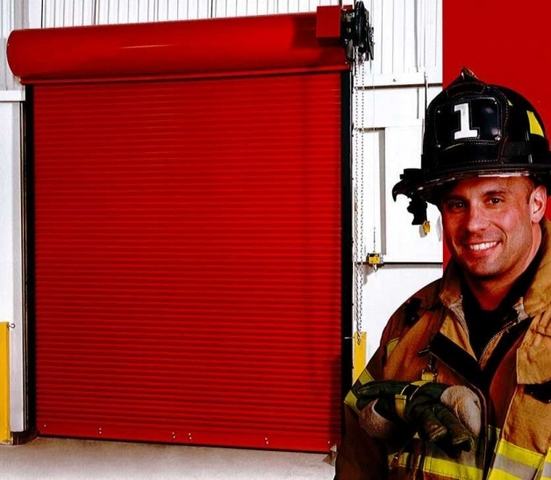
HAVE YOUR FIRE DOORS
TESTED ANNUALLY BY
HAMBURG OVERHEAD DOOR
CONTACT OUR OFFICE @ 716-649-3600
info@hamburgdoor.com

